Slide 1
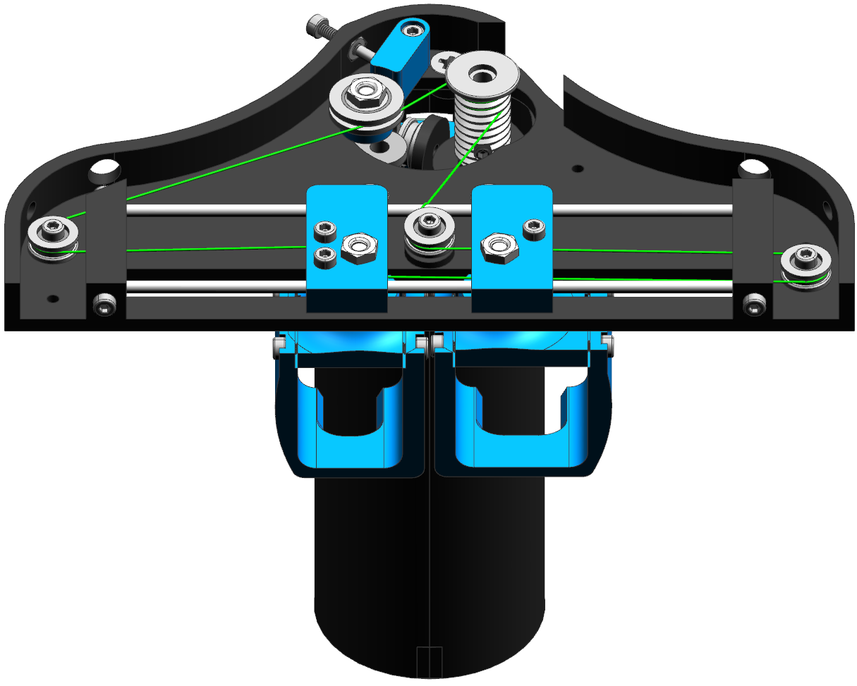


HAPTIC DEVICE INTERFACE APP

